Slide 1


Introduction to RNA-Seq – Differential Expression
Wandrille Duchemin
Notes:
1

Slide 2
How to define statistical significance?
?
Total reads mapped to GeneX

Slide 3

Statistical modeling of RNA-Seq data
Essentially, two approaches
Non-parametric: eg voom (based on limma)
Parametric: eg edgeR and DESeq2
We will be working with the parametric approaches packaged in edgeR and DESeq2
Important assumptions:
most genes are not differentially expressed
probability of a read mapping to geneX is the same for all samples in a class

Slide 4
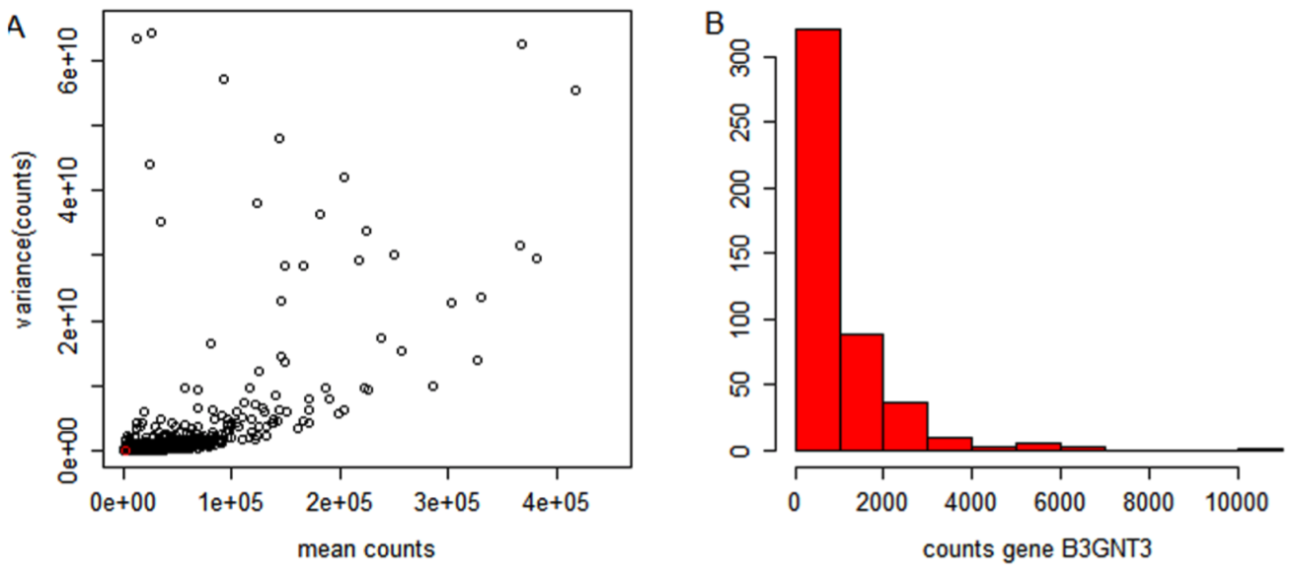
Challenges for RNA-Seq
Which statistical distribution is most appropriate?
How to normalize read counts between samples?
Estimating variance is difficult
Typically, very few replicates
The variance depends on the mean count
Distribution of counts is highly skewed
Zweiner et al, PLoS ONE 2014

Slide 5
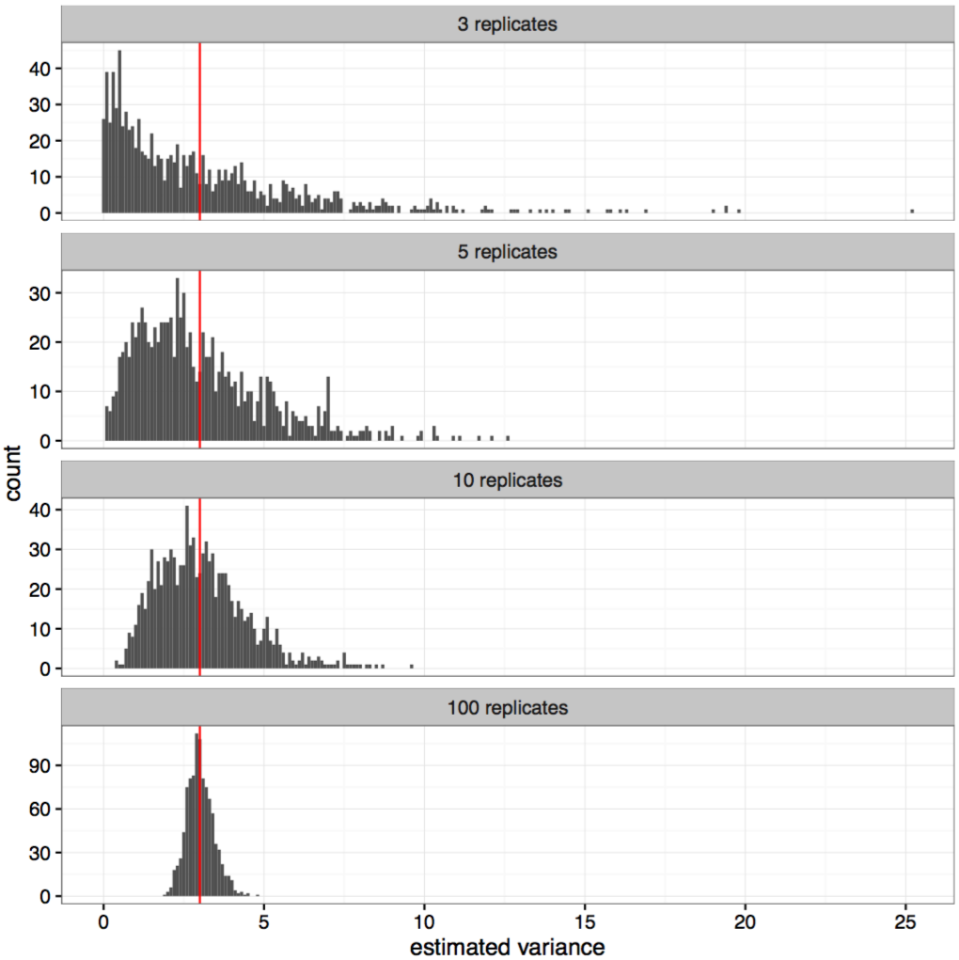
Estimating variance of a normally distributed variable
True variance = 3
What does this tell you about the ideal number of replicates for your RNA-Seq experiment?
Charlotte Soneson

Slide 6
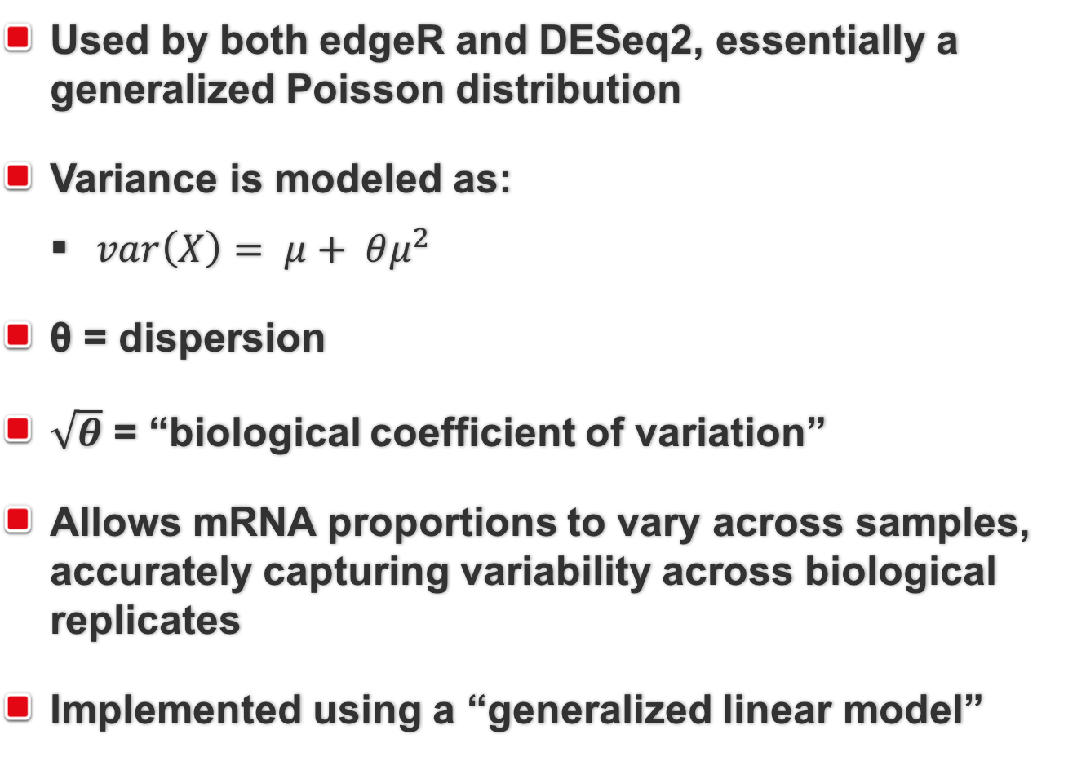
The negative binomial distribution

Slide 7
Normalization of RNA-Seq data
Raw read counts are not directly comparable across samples. They depend on:
Abundance in source material
Gene length
Sequencing depth
Sequencing biases
…
edgeR uses the “Trimmed Mean of M-Values” (TMM) method
DESeq2 uses the “Relative Log Expression” (RLE) method

Slide 8
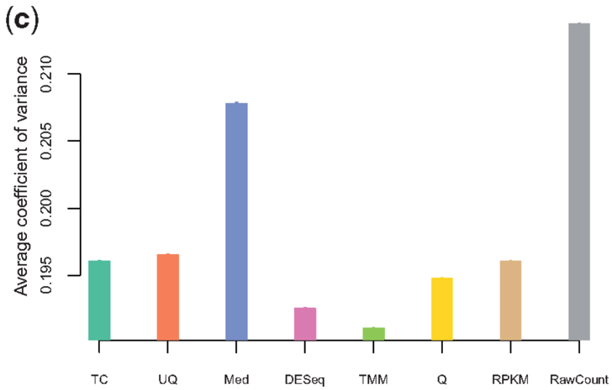
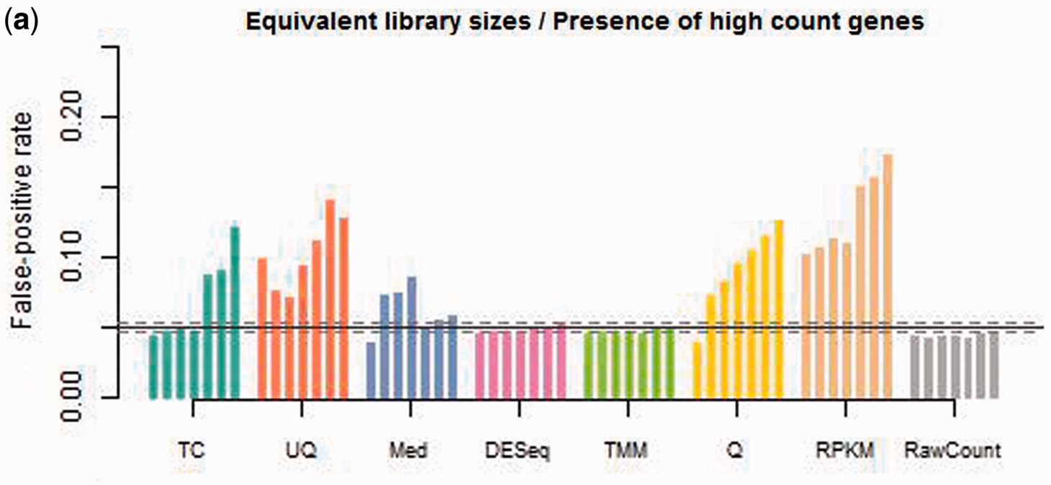
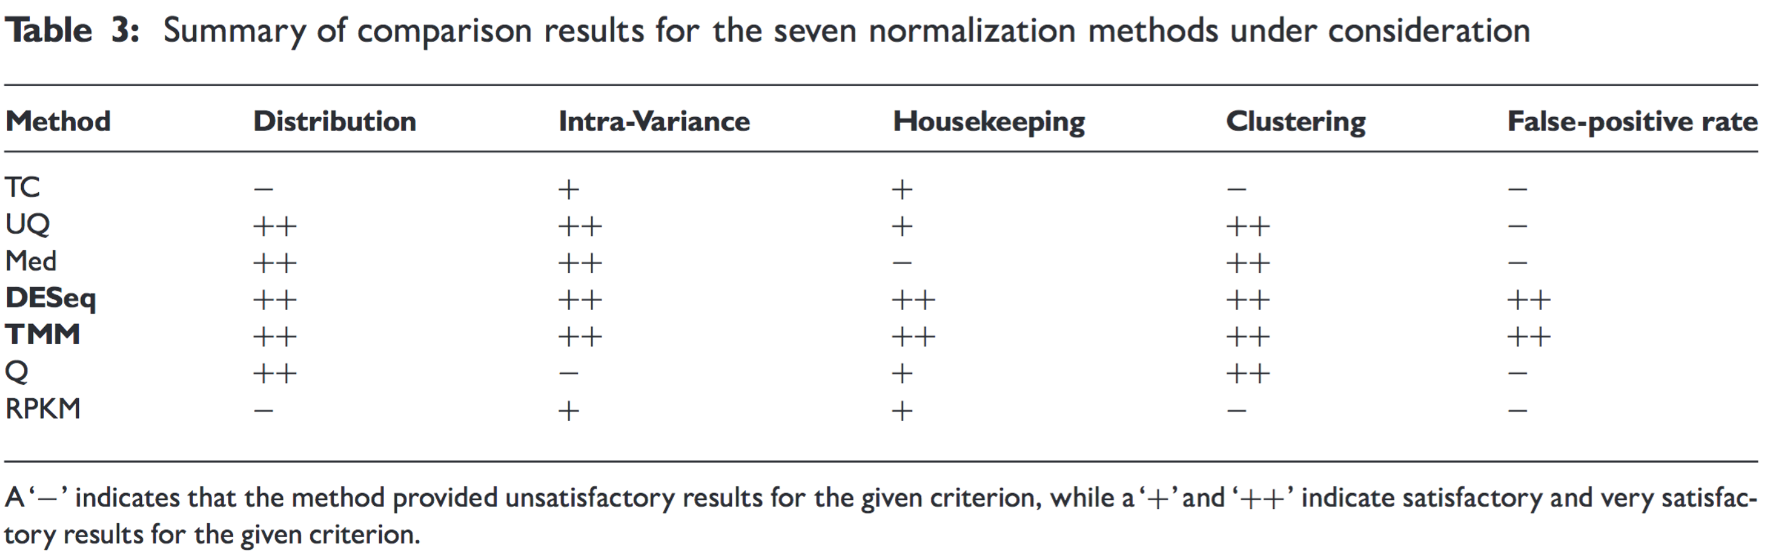
TMM and RLE normalization yield comparable results
Dillies et al 2013

Slide 9
TMM and RLE normalization yield comparable results
Keep in mind that “normalization factors” from edgeR and “size factors” from DESeq2 are not equivalent theoretical parameters
For a more detailed discussion, see Maza 2016

Slide 10
Shrinkage of dispersion estimates
Problem: we often have few replicates
Solution: take advantage of the large number of genes, shrink the gene-wise estimates towards a center value defined by the observed distribution of dispersions across:
All genes (“common” dispersion estimate)
Genes with similar expression (“trended” dispersion estimate)

Slide 11
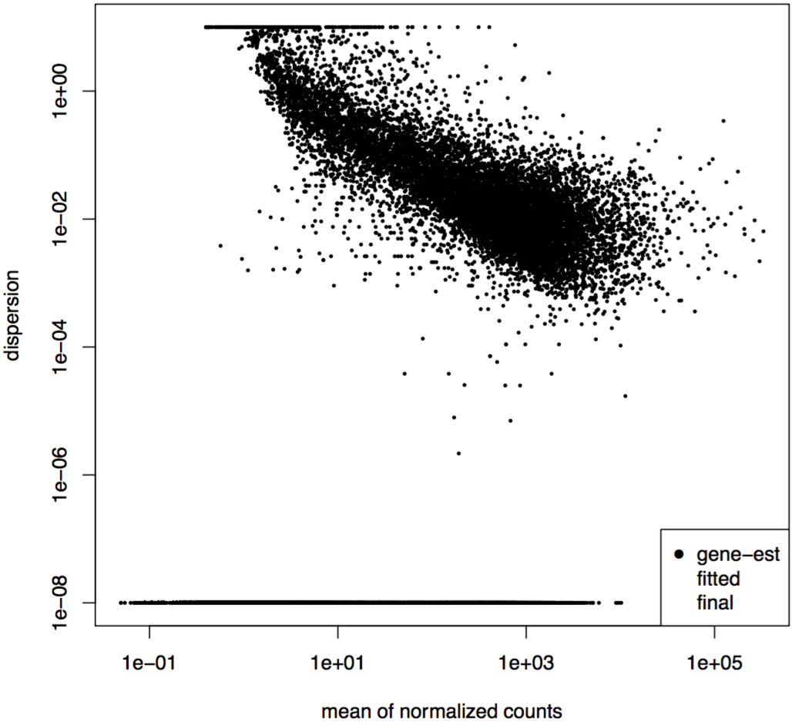
Shrinkage dispersion estimation
Charlotte Soneson

Slide 12
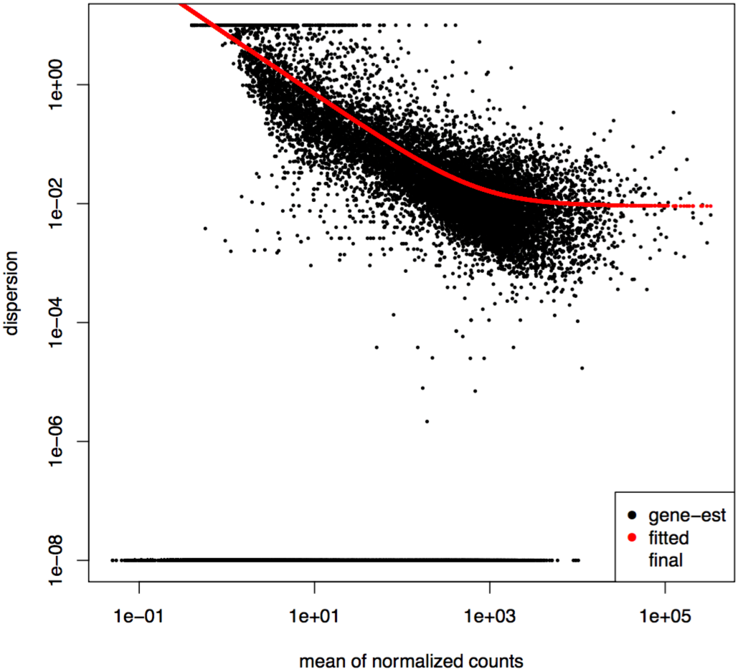
Shrinkage dispersion estimation
Charlotte Soneson

Slide 13
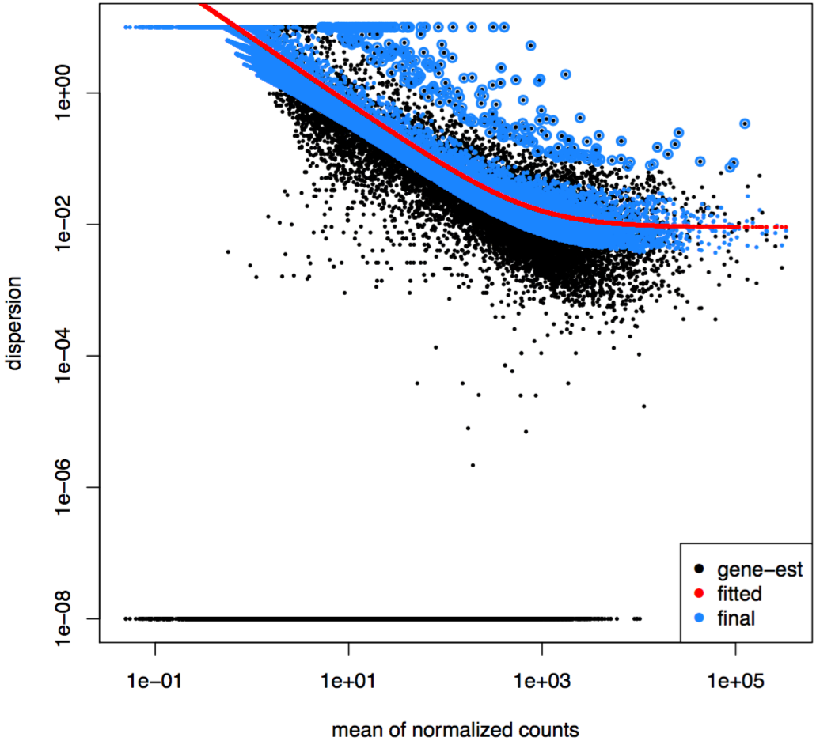
Shrinkage dispersion estimation
Charlotte Soneson

Slide 14
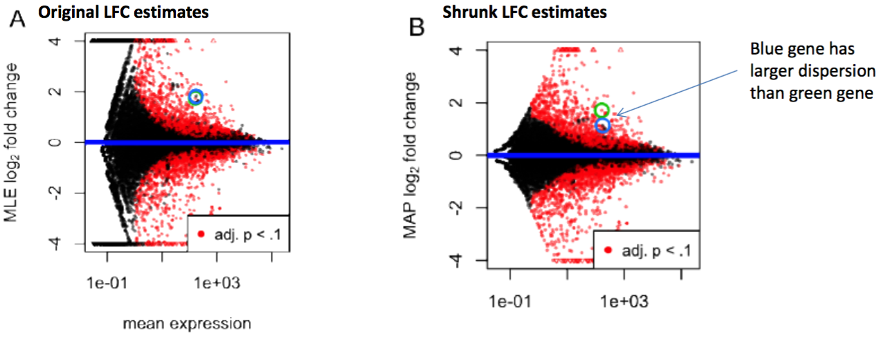
Shrinkage of log-fold change
Problem: weakly expressed genes tend to show much stronger differences between conditions, because count data are very noisy when counts are low
Solution: shrink LFC estimates toward 0 such that shrinkage is stronger when less info is available (eg low counts, high dispersion, low replicates)
Love et al 2014

Slide 15
Tests for differential expression – DESeq2
A Z-score is calculated for each gene by dividing the shrunken LFC estimate by the standard error of the estimate
The Z-score is compared to a standard normal distribution to obtain a P-value (Wald test)
To correct for multiple testing, adjusted p-values are calculated using the Benjamin-Hochberg procedure
Consider a genome with 20,000 genes
At a threshold of p = 0.05, we would expect 1000 significant tests even if there is NO differential expression
Notes:
Note: The multiple test correction in DESeq2 considers only genes that could potentially be detected as differentially expressed. Only these genes will have an adjusted P-value. The mean read count across all samples is used to decide if a gene should be included or not.
1

Slide 16
Tests for differential expression – edgeR
Different methods for different cases :
“simple” 1 factor : exactTest() , using the computed conditional distribution for the sum of counts in a group
Otherwise a GLM framework in used :
QL F-test : is preferred because it gives “stricter error rate control by accounting for the uncertainty in dispersion estimation… (which can be considerable when you have few replicates and/or the amount of shrinkage is low), whereas the other methods do not”
LRT : when “the dispersions are very large and the counts are very small, whereby some of the approximations in the QL framework seem to fail”
Notes:
Note: The multiple test correction in DESeq2 considers only genes that could potentially be detected as differentially expressed. Only these genes will have an adjusted P-value. The mean read count across all samples is used to decide if a gene should be included or not.
<number>

Slide 17
edgeR vs DESeq2
https://mikelove.wordpress.com/2016/09/28/deseq2-or-edger/

Slide 18
edgeR “Robust” Mode
Dispersion estimates can be sensitive to outliers. If this is a significant aspect of your dataset, edgeR has a more robust implementation to estimate dispersions:
https://www.rdocumentation.org/packages/edgeR/versions/3.14.0/topics/estimateGLMRobustDisp

Slide 19
Practical
Go to the website and follow the Differential Expression Inference practical

Slide 20
Enrichment analysis
What to do with your list of differentially expressed gene ?
Interpretation can be difficult, especially when many genes are DE

Slide 21
Enrichment analysis
What to do with your list of differentially expressed gene ?
Interpretation can be difficult, especially when many genes are DE
We facilitate this by “translating” this from a list of genes to a more readily interpretable set : biological functions, pathways, transcription factors, …

Slide 22
Enrichment analysis
What to do with your list of differentially expressed gene ?
Interpretation can be difficult, especially when many genes are DE
We facilitate this by “translating” this from a list of genes to a more readily interpretable set : biological functions, pathways, transcription factors, …
2 main aspects:
Mapping from genes to interpretable objects
Method to determine significant enrichment

Slide 23
Enrichment analysis - mapping
The goal is to regroup certain genes together in meaningful sets
Genes involved in the same pathway (eg. DNA repair)
Genes located in the same biological compartment
Genes with a similar molecular function
Genes regulated by the same transcription factor
…

Slide 24
Enrichment analysis - mapping
A few of the possibilities :
Gene Ontology
Reactome
KEGG
MSigDB
Custom set
…

Slide 25
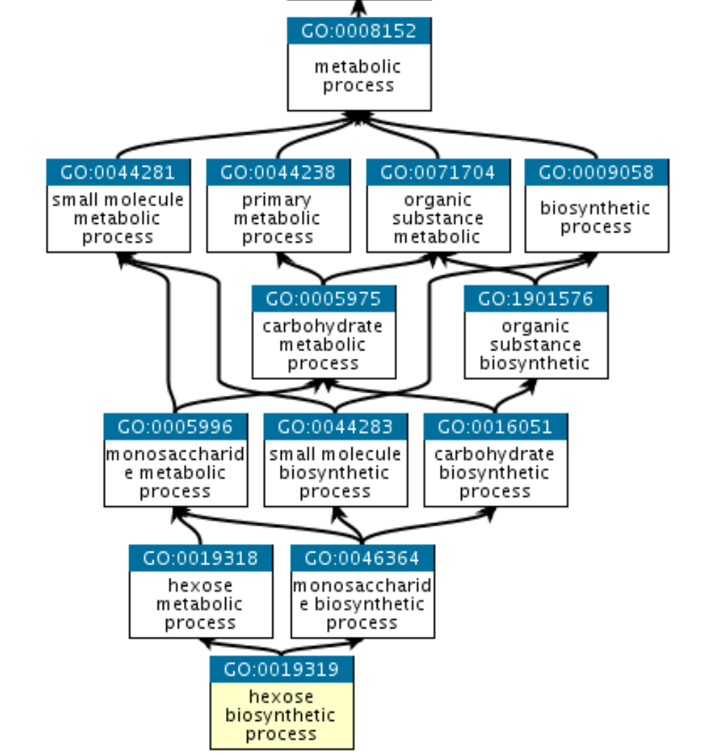
Enrichment analysis - mapping
Gene ontology : http://geneontology.org
3 domains of nested terms:
Molecular Function
Cellular Component
Biological Process

Slide 26
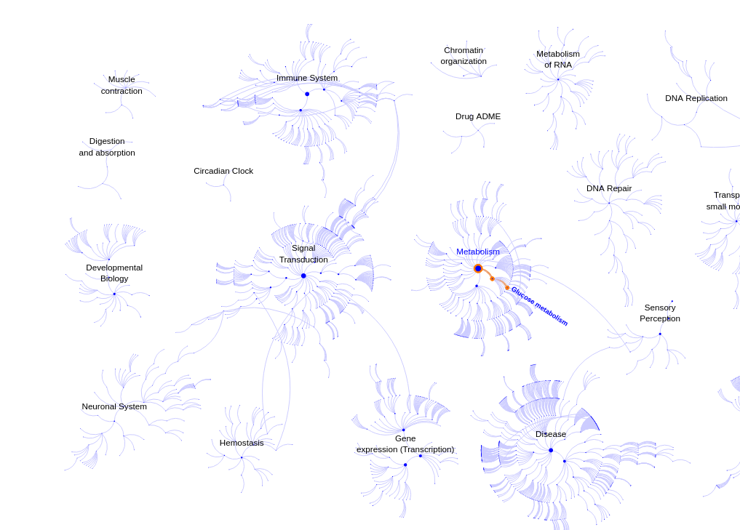
Enrichment analysis - mapping
Reactome : https://reactome.org

Slide 27
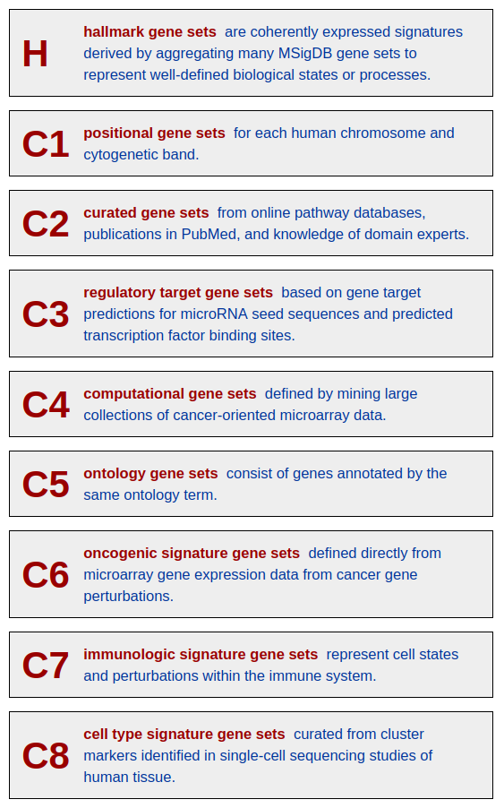
Enrichment analysis - mapping
MSigDB : http://www.gsea-msigdb.org/gsea/msigdb/index.jsp
Human mouse and rat only

Slide 28
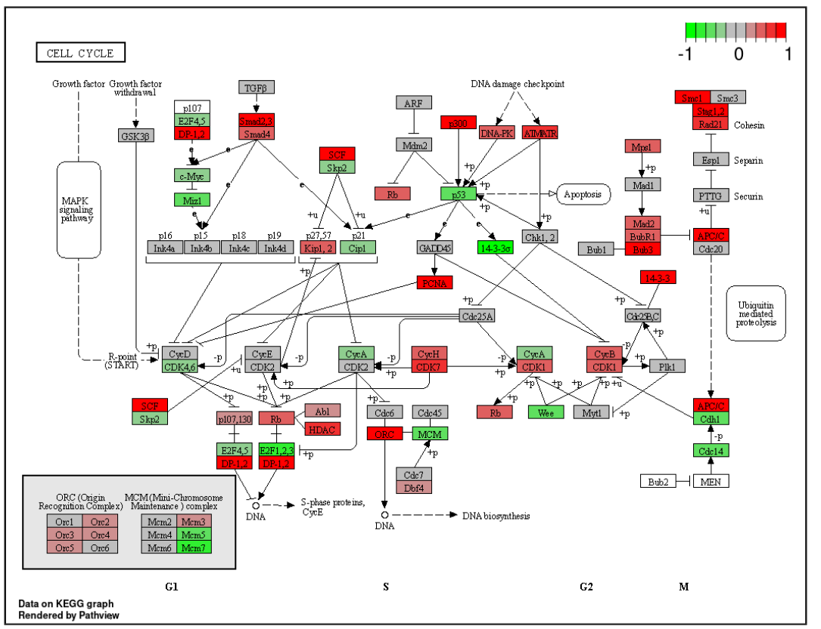
Enrichment analysis - mapping
KEGG : https://www.genome.jp/kegg/ - KEGG PATHWAY
Projection of DE data
onto a KEGG pathway map
With R package pathview
https://bioconductor.org/packages/release/bioc/html/pathview.html

Slide 29
Enrichment analysis - mapping
Custom gene sets :
Derived from specialized litterature
Tentative annotation
Understudied organisms
...

Slide 30
Enrichment analysis – computing enrichment
2 possible approaches (among many!)
Over-representation analysis
Gene Set Enrichment Analysis

Slide 31
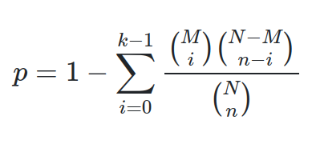
Enrichment analysis – computing enrichment
2 possible approaches (among many!)
Over-representation analysis
Fisher’s exact test (with p-val correction)
 | DE | Not DE
in gene set | A | B
not in gene set | C | D
N = A+B+C+D # total genes
M = A+B # genes in set
n = A+C # DE genes
k = A # DE genes in set

Slide 32
Enrichment analysis – computing enrichment
2 possible approaches (among many!)
Gene Set Enrichment Analysis
Do not rely on 0/1 DE status, but on a continuous measurement (eg. log2FC)
Computes Enrichment Score from list of ranked genes
Estimates significance using permutations

Slide 33
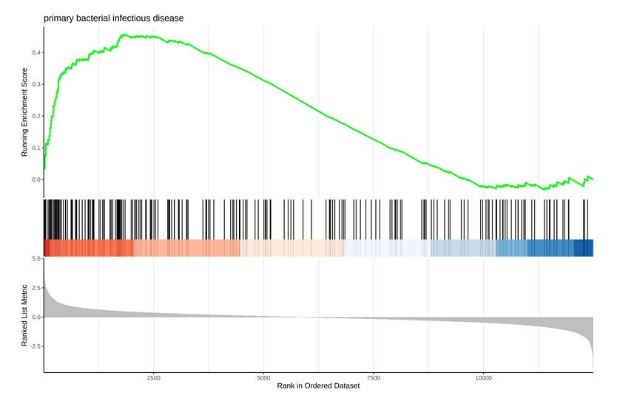
Enrichment analysis – computing enrichment
Enrichment Score visualized using functions from the R package enrichplot
http://www.bioconductor.org/packages/release/bioc/html/enrichplot.html

Slide 34
Enrichment analysis – computing enrichment
Many more methods or implementations:
Signaling Pathway Impact Analysis
https://bioconductor.org/packages/release/bioc/html/SPIA.html
ISMARA
https://ismara.unibas.ch/mara/
...

Slide 35
Practical
Go to the website and follow the Enrichment practical
Also, maybe give a try to gProfiler, and ORA tool developed and maintained in Estonia:
https://biit.cs.ut.ee/gprofiler/gost

Slide 36
REFERENCES
Zwiener I, Frisch B, Binder H (2014) Transforming RNA-Seq Data to Improve the Performance of Prognostic Gene Signatures. PLOS ONE 9(1): e85150. https://doi.org/10.1371/journal.pone.0085150
Dillies et al. (2013) A comprehensive evaluation of normalization methods for Illumina high-throughput RNA sequencing data analysis. Brief Bioinform. Nov;14(6):671-83. doi: 10.1093/bib/bbs046
Maza (2016) In Papyro Comparison of TMM (edgeR), RLE (DESeq2), and MRN Normalization Methods for a Simple Two-Conditions-Without-Replicates RNA-Seq Experimental Design. Front. Genet. https://doi.org/10.3389/fgene.2016.00164

Slide 37
Contributors: Geoffrey Fucile Walid Gharib Irene Keller Pablo Escobar Lopez Charlotte Soneson

